Slide 1
PROJECT WAVE
ADHISH J S - EC23B1003
SAI PRAMATHI MAKKENA - EC23B1028
PRATEEK RAO - EC23B1039

Slide 2
INTRODUCTION
Presentation is extremely important in many different aspects of life. However, the constant usage of keyboard to change slides over a specific gadget to complete chores renders them lifeless.
This project involves using gestures to control various actions on a PowerPoint presentation.

Slide 3
TEAM MEMBERS

Slide 4
Team Lead
Responsible for backend operations
Debugging of the project.
Testing the code
Flagging the issues and bugs
Designing Presentations
ADHISH
PRAMATHI
PRATEEK
Resource Management
Proposing ideas for the project
Outreach and Presentation

Slide 5
OBJECTIVES
This project aims to provide ease of accessibility to the presenter by reducing the inputs of keyboard and mouse.
A standard web camera is used to accept hand gestures from the presenter to navigate through the slides
Thus the presenter does not need to repeatedly turn to his device to switch through the slides. Rather he could do all this with the flick of his hand

Slide 6
PROBLEM
STATEMENTS
Develop a system to recognise hand gestures in real-time.
Create functionality for navigating slides using captured gestures.

Slide 7
EXISTING
SYSTEMS
Motion sensing feature utilised by PlayStation 4 Controllers.
Anti-Theft Systems
Used in home appliances such as lights.

Slide 8
HARDWARE
Webcam
A device supporting Python programming language.
SOFTWARE
Operating System
Python IDE(Version 3.9 or greater)
Libraries
Text Editor
Compatible Presentation Software
IMPLEMENTATION REQUIREMENTS

Slide 9
BASIC PYTHON CONCEPTS
CONDITIONAL STATEMENTS
LOOPS
IMPORTING MODULES
VARIABLES

Slide 10
PYTHON DATA STRUCTURES
LISTS
TUPLES
DICTIONARIES
SETS
BOOLEAN VALUES

Slide 11
PYTHON OOPS
CONCEPTS
CLASSES
OBJECTS
ENCAPSULATION
INHERITANCE
ABSTRACTION
POLYMORPHISM
CONSTRUCTOR METHOD

Slide 12
MODULES
Mediapipe: Facilitates processing media data such as video and audio and also supports face detection,hand tracking and object detection.
Cv2: Provides tools for computer vision and image processing tasks. It allow computers to identify objects,faces or even the motion of objects across frames.
Psutil: It can provide details about the computer’s CPU,memory,disks,network,running processes.
Pyautogui: Facilitates automation on computer by controlling the mouse and keyboard programmatically.

Slide 13
FLOW OF DATA

Slide 14
The image is captured through a webcam and is detected by the computer with the help of OpenCv module
The Psutil accesses the tasks currently running in the computer and ensures that the code gets executed only when a compatible process gets initiated
Image Capture & Detection
Image Processing
Task Management
Automation
Mediapipe processes the image to be utilised with the Hand Tracking module
Pyautogui module translates the hand gestures into inputs through keyboard and mouse

Slide 15
CONTRIBUTIONS
Educational Resource
User Experience Improvement
Feedback
Hands free alternative to traditional input devices

Slide 16
OUTCOMES
USER FRIENDLY INTERFACE:
Enables user to easily understand hand controlled gestures.
REAL-TIME RESPONSE:
Real-time response ensures to provide a seamless experience.
DEMO AND TUTORIALS:
Going through the documentation and tutorials is easier for the user.
ACCESSIBILITY:
Upgrades the accessibility for users with mobility impairments.

Slide 17
CODE
SNIPPET

Slide 18
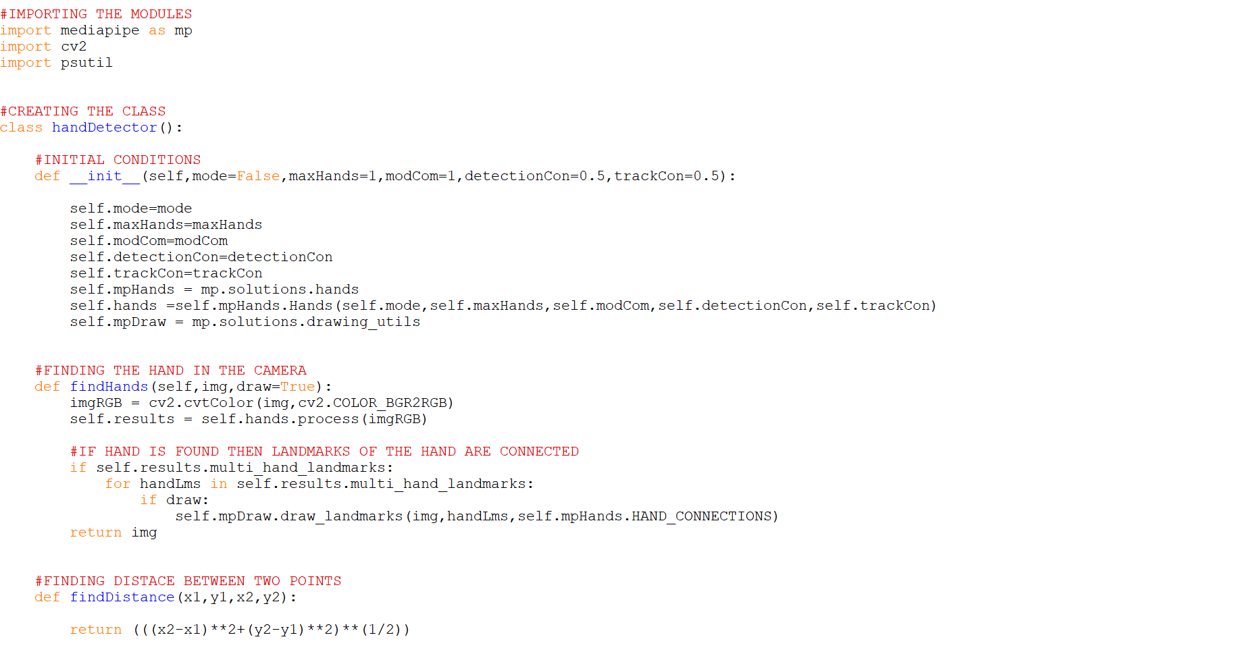

Slide 19
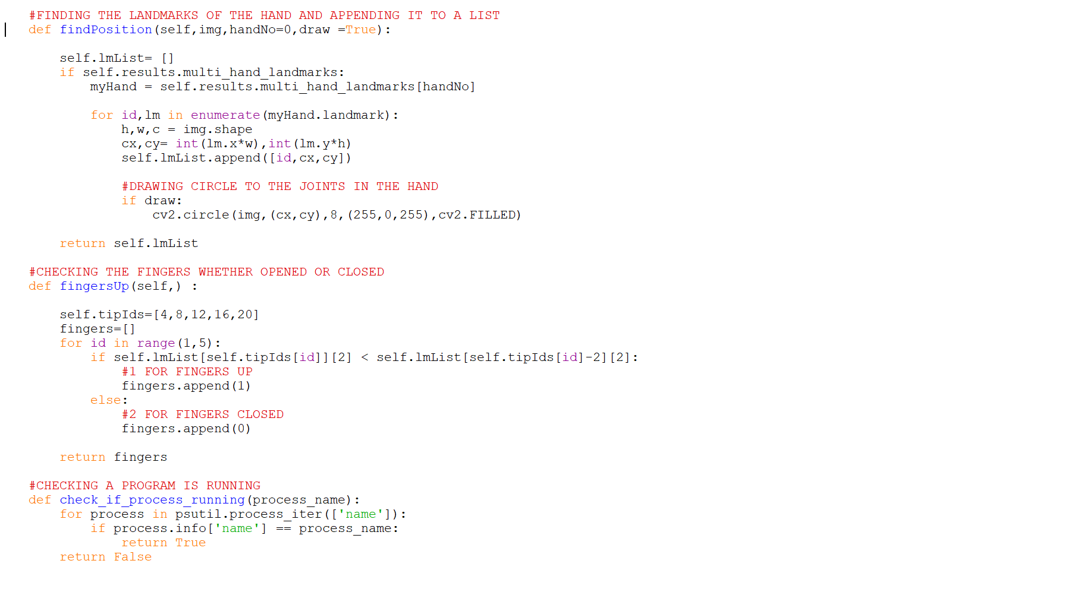

Slide 20
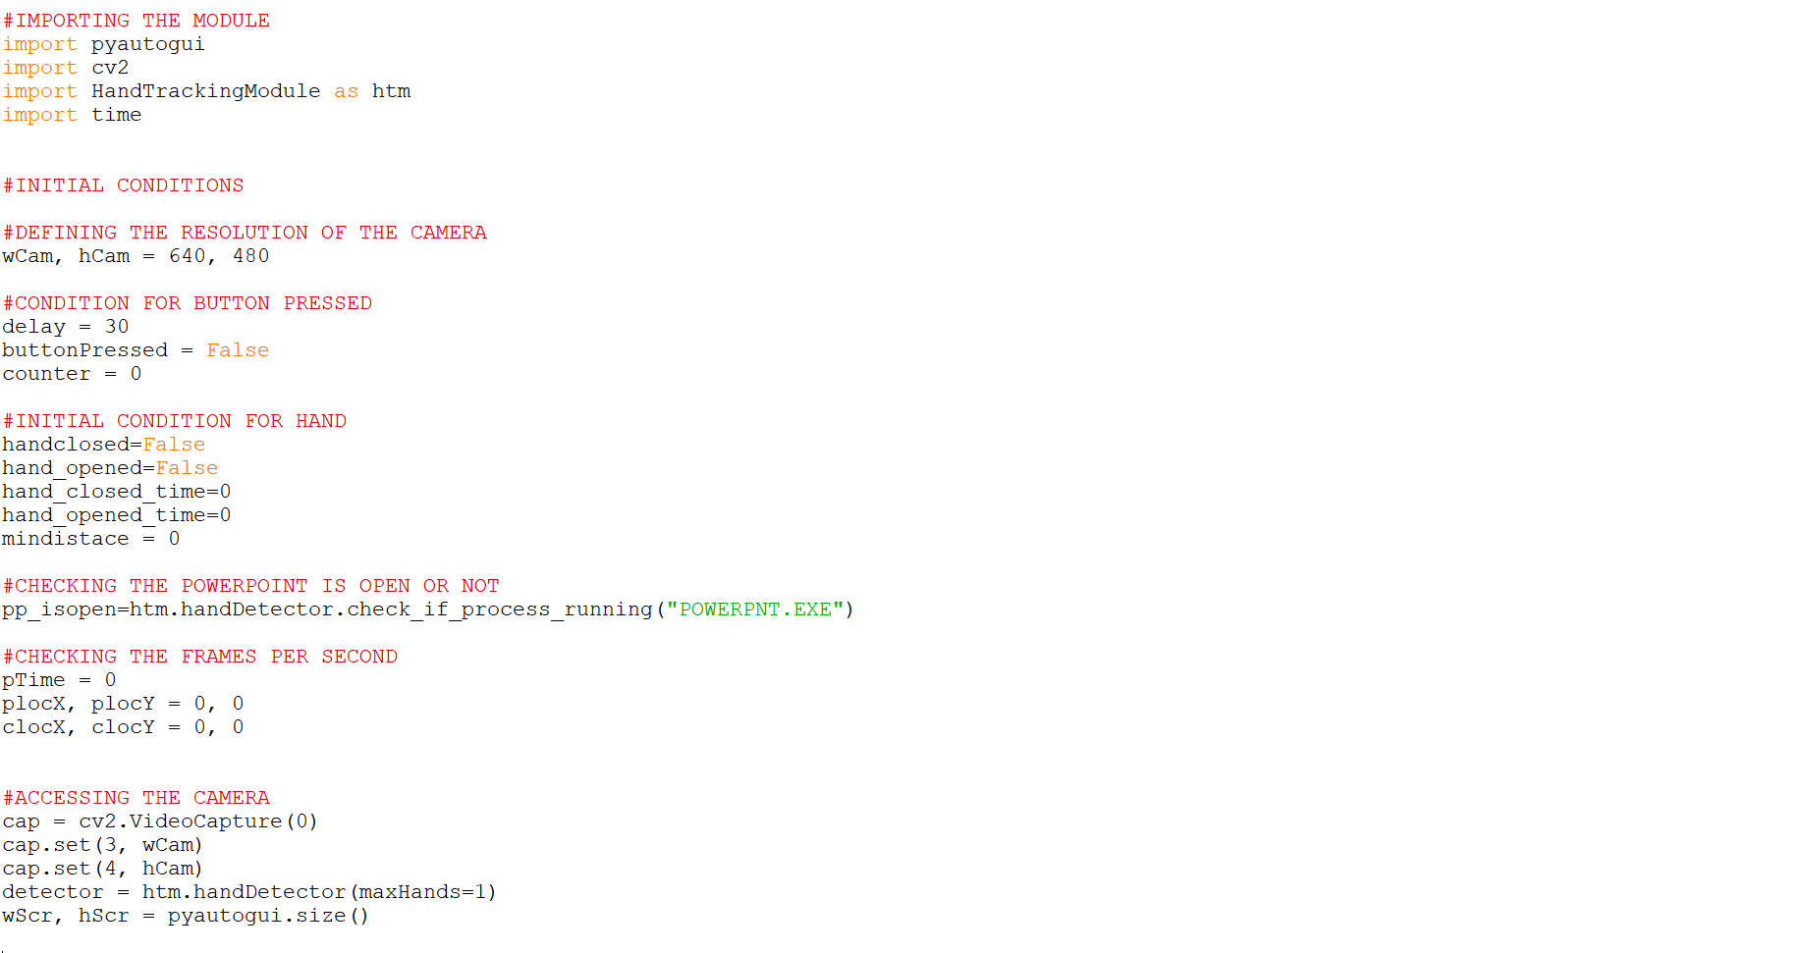

Slide 21
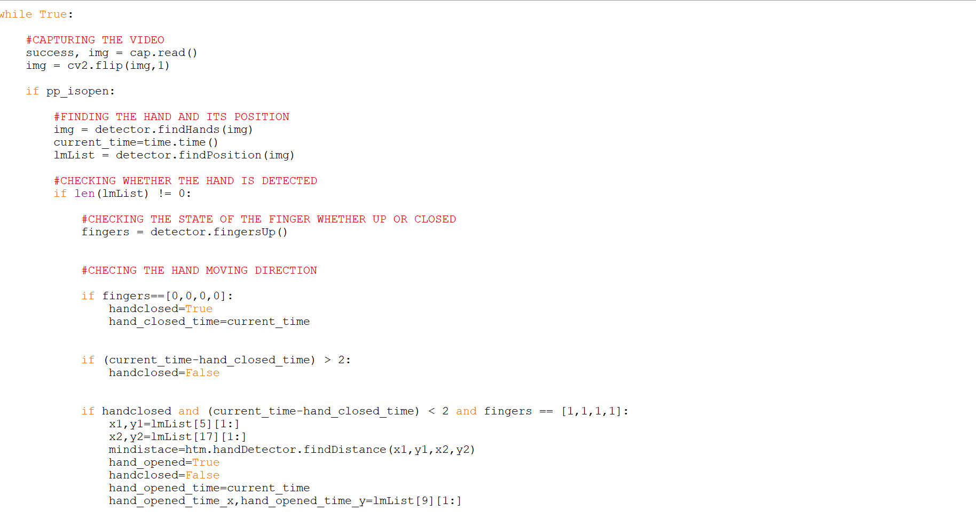

Slide 22
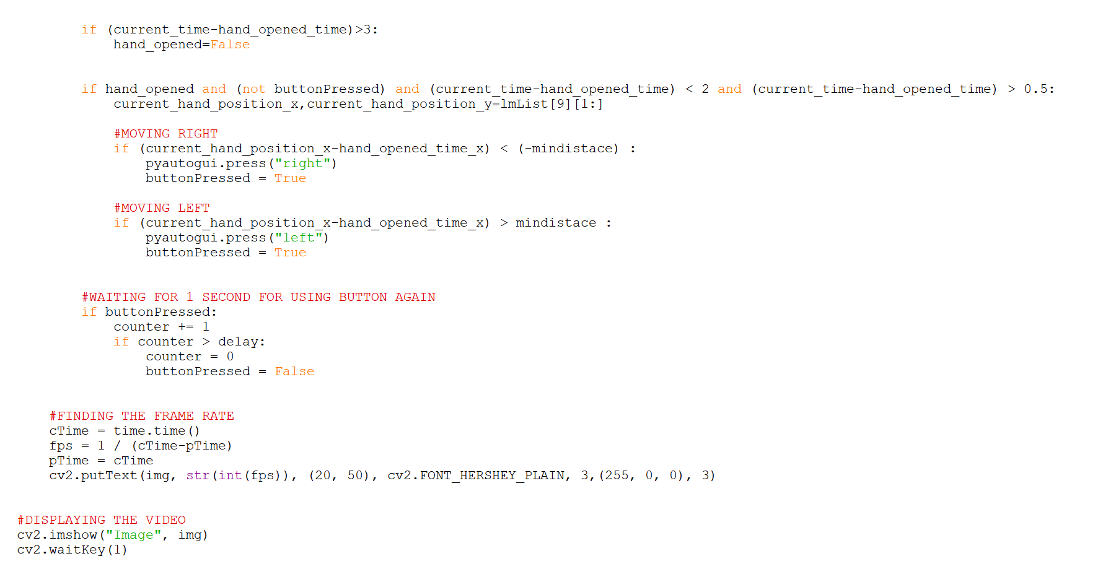

Slide 23
REFERENCE
geeksforgeeks.org
wikipedia.org
pypi.org
docs.python.org

Slide 24
DISADVANTAGES
Limited accuracy in recognition
Not suitable for use in improper lighting conditions

Slide 25
THANK
YOU !

